Slide 1

DEPARTMENT OF COMPUTER SCIENCE AND ENGINEERING
UNIT III
1151CS117 – Java Programming
Course Coordinator : Dr. Dhilip Kumar
COURSE HANDLING FACULTY : Mrs S.Uma

Slide 2

UNIT III I/O STREAMS, STRINGS AND COLLECTIONS
Character Streams
Stream I/O
Serialization
Files
String Class
String handling
java. util. Collections
Collections Frameworks
Generic Classes and Methods.

Slide 4
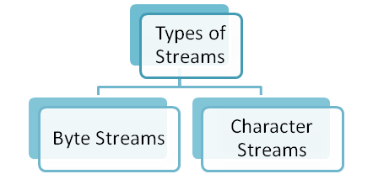
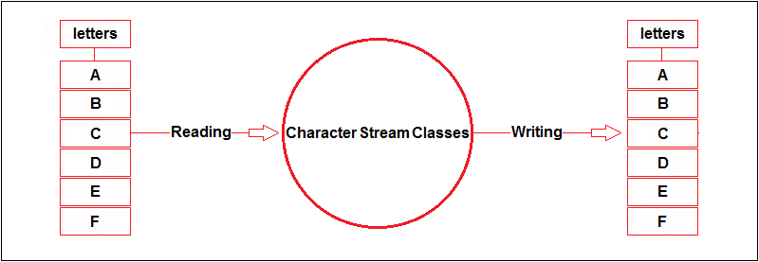
Character Streams

Slide 5
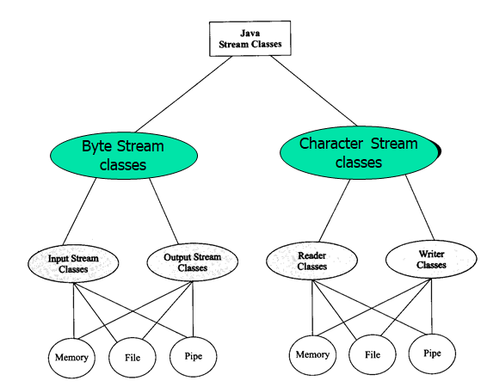
Character Streams
These provide a convenient way for handling character inputs and output.
These streams end up calling by a word “Reader” or “Writer” like InputStreamReader, FileReader, OutputStreamWriter, FileWriter etc.

Slide 6
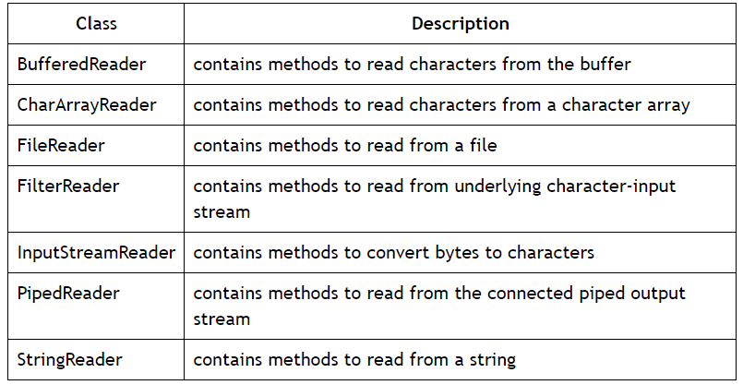
Reader Classes
Reader classes are used to read 16-bit unicode characters from the input stream.
The Reader class is the superclass for all character-oriented input stream classes.

Slide 7
Buffered Reader Example
import java.io.*;
class BufferedReaderExample {
publicstaticvoid main(String args[])throwsIOException{
String s="This program is skipping first character of each word in the string";
StringReader sr = newStringReader(s);
System.out.println("The input string is: "+s);
/*Creating an instance of BufferedReader using StringReader*/
BufferedReader br = newBufferedReader(sr);
//Reading from the underlying StringReader
System.out.print ("The output string is: ");
br.skip(1);
/*skipping the first character of the first word of the input string*/
//reading the remaining string
int i=0;
while((i=br.read())!=-1){
System.out.print((char)i);
if((char)i==' ')
//checking for white spaces
{
br.skip(1);
/*skipping first character of each word*/
} } } }
The output of the program is
The input string is: This program is skipping first character of each word in the string
The output string is: his rogram s kipping irst haracter f ach ord n he tring In this program, skip () method is used to skip the first character of each word of the input string.

Slide 8
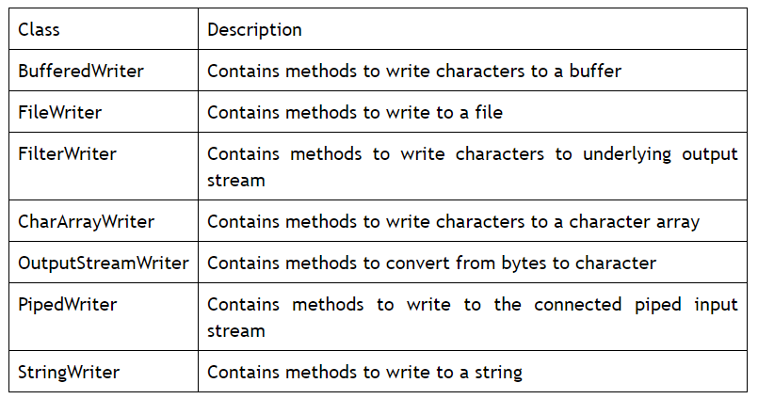
Writer Classes
Writer classes are used to write 16-bit Unicode characters onto an outputstream.
The Writer class is the superclass for all character-oriented output stream classes

Slide 9
BufferedWriter Class
import java.io.*;
class BufferedWriterExample {
public static void main(String args[]) throws IOException {
String s = "This is an example of BufferedWriter";
StringWriter sw = new StringWriter();
//creating an instance of BufferedWriter class
BufferedWriter bw = new BufferedWriter(sw);
bw.write(s,0,5);
bw.newLine();
bw.write(s,5,s.length()-5);
/*writes the substring starting from index 5*/
bw.flush() ;
//flushes the stream
System.out.println(sw.getBuffer());
sw.close();
//closing the stream
bw.close();
//closing the stream
}
}
The output of the program is
This is an example of BufferedWriter

Slide 10
Stream I/O

Slide 11
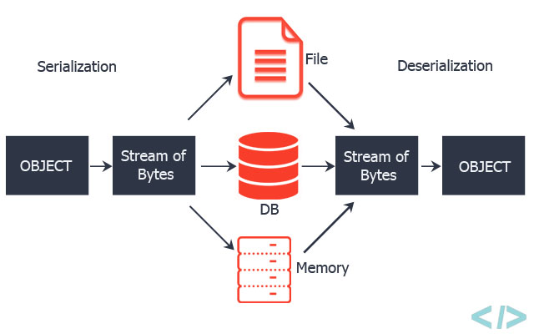
Serialization
Serialization in Java is a mechanism of writing the state of an object into a byte-stream. It is mainly used in Hibernate, RMI, JPA, EJB and JMS technologies.
The reverse operation of serialization is called deserialization where byte-stream is converted into an object.

Slide 12
Example of Java Serialization
import java.io.*;
class Persist{
public static void main(String args[]){
try{
//Creating the object
Student s1 =new Student(211,"ravi");
//Creating stream and writing the object
FileOutputStream fout=new FileOutputStream("f.txt");
ObjectOutputStream out=new ObjectOutputStream(fout);
out.writeObject(s1);
out.flush();
//closing the stream
out.close();
System.out.println("success");
}catch(Exception e){System.out.println(e);}
}
}

Slide 13
Example of Java Deserialization
import java.io.*;
class Depersist{
public static void main(String args[]){
try{
//Creating stream to read the object
ObjectInputStream in=new ObjectInputStream(new FileInputStream("f.txt"));
Student s=(Student)in.readObject();
//printing the data of the serialized object
System.out.println(s.id+" "+s.name);
//closing the stream
in.close();
}catch(Exception e){System.out.println(e);}
}
}

Slide 14
Files
import java.io.*;
public class CopyFile {
public static void main(String args[]) throws IOException {
FileInputStream in = null;
FileOutputStream out = null;
try {
in = new FileInputStream("input.txt");
out = new FileOutputStream("output.txt");
int c;
while ((c = in.read()) != -1) {
out.write(c);
}
}finally {
if (in != null) {
in.close();
}
if (out != null) {
out.close(); } } } }
This is test for copy file.

Slide 15
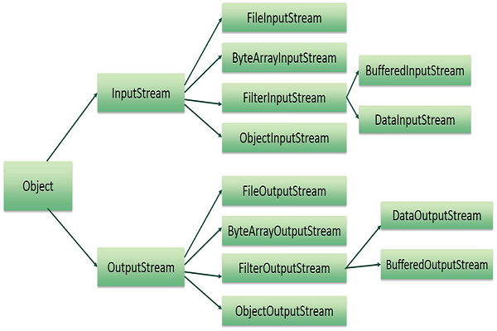
Files

Slide 16
File Input and Output Stream
import java.io.*;
public class fileStreamTest {
public static void main(String args[]) {
try {
byte bWrite [] = {11,21,3,40,5};
OutputStream os = new FileOutputStream("test.txt");
for(int x = 0; x < bWrite.length ; x++) {
os.write( bWrite[x] ); // writes the bytes
}
os.close();
InputStream is = new FileInputStream("test.txt");
int size = is.available();
for(int i = 0; i < size; i++) {
System.out.print((char)is.read() + " ");
}
is.close();
} catch (IOException e) {
System.out.print("Exception");
}
}
}
The above code would create file test.txt and would write given numbers in binary format

Slide 17
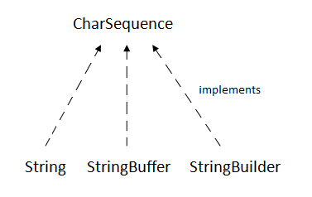
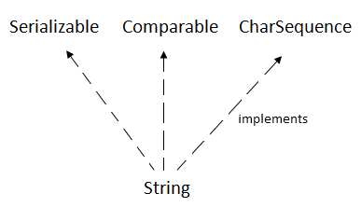
String Class & String handling

Slide 18
Java String class functions
charAt() method
public class Demo {
public static void main(String[] args) {
String str = "studytonight";
System.out.println(str.charAt(2));
}
}
Output
u
public class StudyTonight {
public static void main(String[] args) {
String str="StudyTonight";
System.out.println(str.indexOf('u')); //3rd form
System.out.println(str.indexOf('t', 3)); //2nd form
String subString="Ton";
System.out.println(str.indexOf(subString)); //1st form
System.out.println(str.indexOf(subString,7)); /4th form
}
}
Output
2
11
5
-1

Slide 19
replace() & substring() method
public class Demo {
public static void main(String[] args) {
String str = "Change me";
System.out.println(str.replace('m','M'));
}
}
Output
Change Me
public class Demo {
public static void main(String[] args) {
String str = "0123456789";
System.out.println(str.substring(4));
System.out.println(str.substring(4,7));
}
}
Output
456789
456

Slide 20
toLowerCase() & toUpperCase()
public class Demo {
public static void main(String[] args) {
String str = "abcdef";
System.out.println(str.toUpperCase());
}
}
Output:
ABCDEF
public class Demo {
public static void main(String[] args) {
String str = "ABCDEF";
System.out.println(str.toLowerCase());
}
}
Output:
abcdef

Slide 21
valueOf() & toString()
public class Demo {
public static void main(String[] args) {
int num = 35;
String s1 = String.valueOf(num);
//converting int to String
System.out.println(s1);
System.out.println("type of num is: "+s1.getClass().getName());
}
}
Output:
35
type of num is: java.lang.String
public class Car {
public static void main(String args[])
{
Car c = new Car();
System.out.println(c);
}
public String toString()
{
return "This is my car object";
}
}
Output:
This is my car object

Slide 22
contains() & endsWith()
public class Demo {
public static void main(String[] args) {
String a = "Hello welcome to studytonight.com";
boolean b = a.contains("studytonight.com");
System.out.println(b);
System.out.println(a.contains("javatpoint"));
}
}
Output:
true
false
public class Demo {
public static void main(String[] args) {
String a="Hello welcome to studytonight.com";
System.out.println(a.endsWith("m"));
System.out.println(a.endsWith("com"));
}
}
Output:
true
true

Slide 23
format() & getChars()
public class Demo {
public static void main(String[] args) {
String a1 = String.format("%d", 125);
String a2 = String.format("%s", "studytonight");
String a3 = String.format("%f", 125.00);
String a4 = String.format("%x", 125);
String a5 = String.format("%c", 'a');
System.out.println("Integer Value: "+a1);
System.out.println("String Value: "+a2);
System.out.println("Float Value: "+a3);
System.out.println("Hexadecimal Value: "+a4);
System.out.println("Char Value: "+a5);
}}
Output
Integer Value: 125
String Value: studytonight
Float Value: 125.000000
Hexadecimal Value: 7d
Char Value: a
public class Demo {
public static void main(String[] args) {
String a= new String("Hello Welcome to studytonight.com");
char[] ch = new char[16];
try
{
a.getChars(6, 12, ch, 0);
System.out.println(ch);
}
catch(Exception ex)
{ System.out.println(ex); } }}
Output
Welcom

Slide 24
join() & startsWith() Method
public class JoinDemo1
{
public static void main(String[] args)
{
String s = String.join("*","Welcome to java.com");
System.out.println(s);
String date1 = String.join("/","23","01","2020");
System.out.println("Date: "+date1);
String time1 = String.join(":", "2","39","10");
System.out.println("Time: "+time1);
}
}
Output:
Welcome to studytonight.com
Date: 23/01/2020
Time: 2:39:10
public class Demo {
public static void main(String[] args) {
String str = "studytonight";
System.out.println(str.startsWith("s"));
System.out.println(str.startsWith("t"));
System.out.println(str.startsWith("study",1));
}
}
Output
true
false
false

Slide 25
Example
Java String Example
public class StringExample{
public static void main(String args[]){
  String s1="java";//creating string by java string literal
  char ch[]={'s','t','r','i','n','g','s'};
  String s2=new String(ch);//converting char array to string
  String s3=new String("example");//creating java string by new keyword
  System.out.println(s1);
  System.out.println(s2);
  System.out.println(s3);
}}
Output
java
strings
example

Slide 26
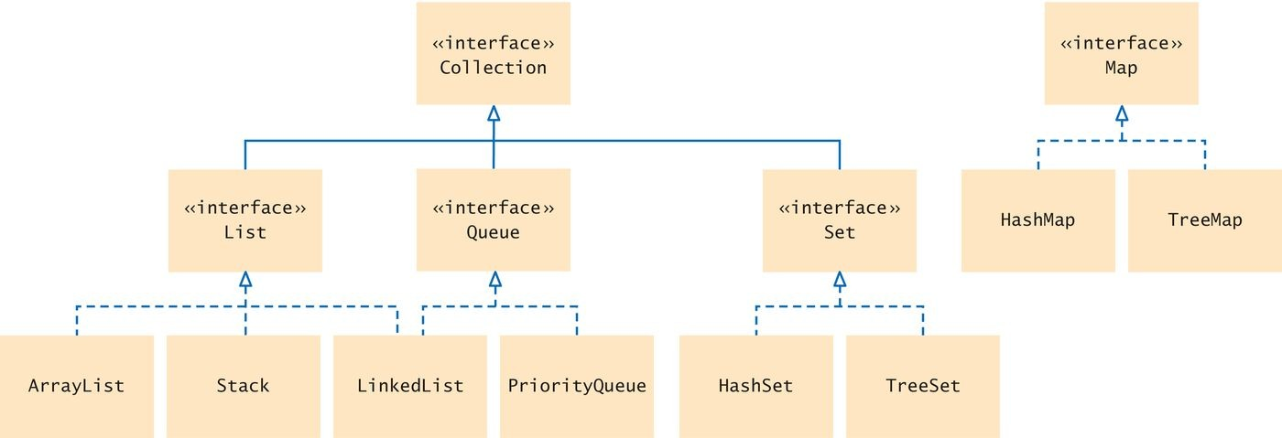

java. util. Collections

Slide 27
Collections
The Collection in Java is a framework that provides an architecture to store and manipulate the group of objects.
Java Collections can achieve all the operations that you perform on a data such as searching, sorting, insertion, manipulation, and deletion.
Java Collection means a single unit of objects. Java Collection framework provides many interfaces (Set, List, Queue, Deque) and classes (ArrayList, Vector, LinkedList, PriorityQueue, HashSet, LinkedHashSet, TreeSet).

Slide 28
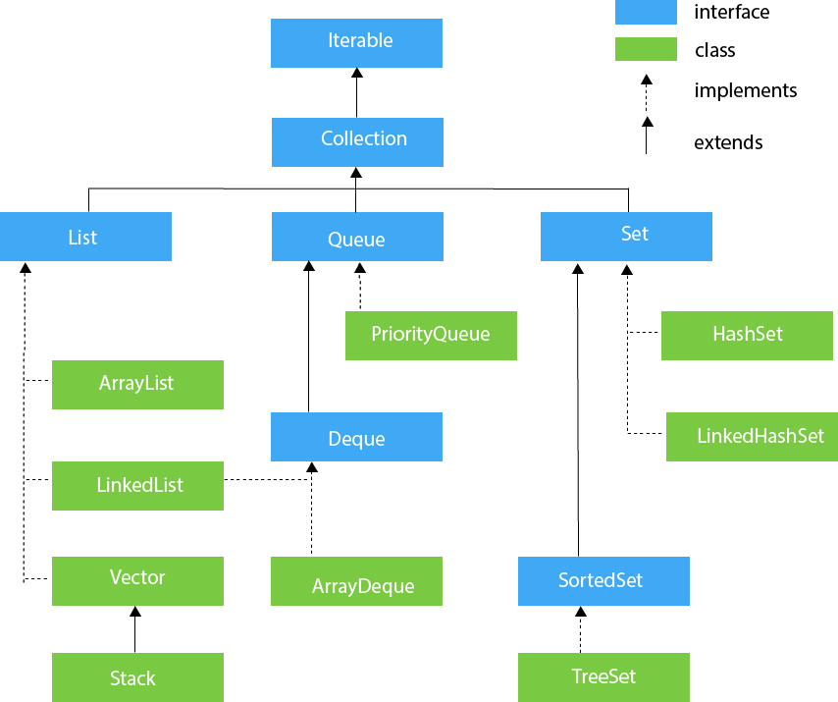
Collections Frameworks

Slide 29
List Interface
ArrayList
import java.util.*;
class TestJavaCollection1{
public static void main(String args[]){
  ArrayList<String> list=new ArrayList<String>();
  //Creating arraylist
  list.add("Ravi");//Adding object in arraylist
  list.add("Vijay");
  list.add("Ravi");
  list.add("Ajay");
  //Traversing list through Iterator
  Iterator itr=list.iterator();
while(itr.hasNext())
{ System.out.println(itr.next()); } } }
Output:
Ravi
Vijay
Ravi
Ajay
List <data-type> list1= new ArrayList();
List <data-type> list2 = new LinkedList();
List <data-type> list3 = new Vector();
List <data-type> list4 = new Stack();

Slide 30
LinkedList & Vector
import java.util.*;
public class TestJavaCollection2{
public static void main(String args[]){
LinkedList<String> al=new LinkedList<String>();
  al.add("Ravi");
  al.add("Vijay");
  al.add("Ravi");
  al.add("Ajay");
  Iterator<String> itr=al.iterator();
while(itr.hasNext()){
System.out.println(itr.next()); } } }
Output:
Ravi
Vijay
Ravi
Ajay
import java.util.*;
public class TestJavaCollection3{
public static void main(String args[]){
  Vector<String> v=new Vector<String>();
  v.add("Ayush");
  v.add("Amit");
  v.add("Ashish");
  v.add("Garima");
  Iterator<String> itr=v.iterator();
while(itr.hasNext()){
System.out.println(itr.next()); } } }
Output:
Ayush
Amit
Ashish
Garima

Slide 31
Stack & ArrayDeque
import java.util.*;
public class TestJavaCollection4{
public static void main(String args[]){
Stack<String> stack = new Stack<String>();
  stack.push("Ayush");
  stack.push("Garvit");
  stack.push("Amit");
  stack.push("Ashish");
  stack.push("Garima");
  stack.pop();
  Iterator<String> itr=stack.iterator();
while(itr.hasNext()){
System.out.println(itr.next()); } } }
Output:
Ayush
Garvit
Amit
Ashish
import java.util.*;
public class TestJavaCollection6{
public static void main(String[] args) {
//Creating Deque and adding elements
Deque<String> deque = new ArrayDeque<String>();
deque.add("Gautam");
deque.add("Karan");
deque.add("Ajay");
//Traversing elements
for (String str : deque) {
System.out.println(str); } } }
Output:
Gautam
Karan
Ajay

Slide 32
HashSet & LinkedHashSet
import java.util.*;
public class TestJavaCollection7{
public static void main(String args[]){
//Creating HashSet and adding elements
HashSet<String> set=new HashSet<String>();
  set.add("Ravi");
  set.add("Vijay");
  set.add("Ravi");
  set.add("Ajay");
  //Traversing elements
  Iterator<String> itr=set.iterator();
while(itr.hasNext()){
System.out.println(itr.next()); } } }
Output:
Vijay
Ravi
Ajay
import java.util.*;
public class TestJavaCollection8{
public static void main(String args[]){
LinkedHashSet<String> set=new LinkedHashSet<String>();
  set.add("Ravi");
  set.add("Vijay");
  set.add("Ravi");
  set.add("Ajay");
Iterator<String> itr=set.iterator();
while(itr.hasNext()){
System.out.println(itr.next()); } } }
Output:
Ravi
Vijay
Ajay

Slide 33
TreeSet
import java.util.*;
public class TestJavaCollection9{
public static void main(String args[]){
//Creating and adding elements
TreeSet<String> set=new TreeSet<String>();
set.add("Ravi");
set.add("Vijay");
set.add("Ravi");
set.add("Ajay");
//traversing elements
Iterator<String> itr=set.iterator();
while(itr.hasNext()){
System.out.println(itr.next()); } } }
Output:
Ajay
Ravi
Vijay

Slide 34
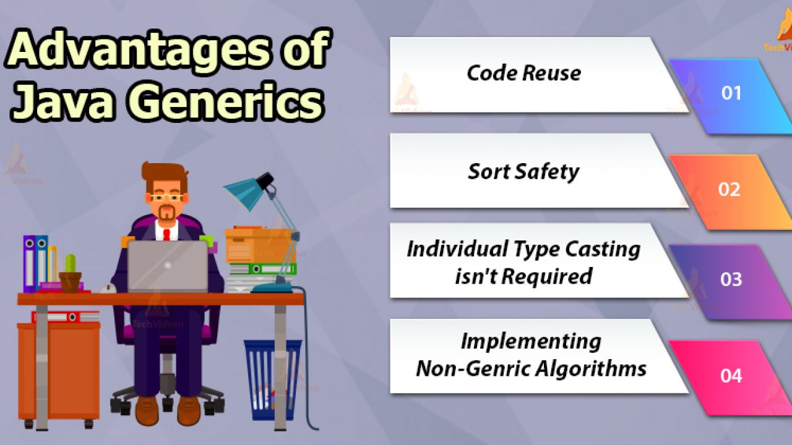
Generic Classes and Methods
Using Java Generic concept, can write a generic method for sorting an array of objects, then invoke the generic method with Integer arrays, Double arrays, String arrays and so on, to sort the array elements.

Slide 35
Generic Classes and Methods
public class GenericMethodTest {
// generic method printArray
public static < E > void printArray( E[] inputArray ) {
// Display array elements
for(E element : inputArray) {
System.out.printf("%s ", element);
}
System.out.println();
}
public static void main(String args[]) {
// Create arrays of Integer, Double and Character
Integer[] intArray = { 1, 2, 3, 4, 5 };
Double[] doubleArray = { 1.1, 2.2, 3.3, 4.4 };
Character[] charArray = { 'H', 'E', 'L', 'L', 'O' };
System.out.println("Array integerArray contains:");
printArray(intArray); // pass an Integer array
System.out.println("\nArray doubleArray contains:");
printArray(doubleArray); // pass a Double array
System.out.println("\nArray characterArray contains:");
printArray(charArray); // pass a Character array
}
}
Output
Array integerArray contains:
1 2 3 4 5
Array doubleArray contains:
1.1 2.2 3.3 4.4
Array characterArray contains:
H E L L O

Slide 36
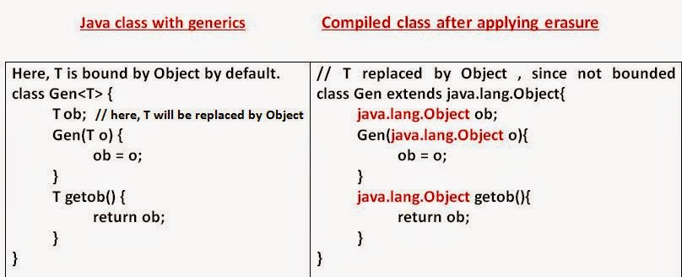
Generic Classes

Slide 37
Generic Classes
public class Box<T> {
private T t;
public void add(T t) {
this.t = t;
}
public T get() {
return t;
}
public static void main(String[] args) {
Box<Integer> integerBox = new Box<Integer>();
Box<String> stringBox = new Box<String>();
integerBox.add(new Integer(10));
stringBox.add(new String("Hello World"));
System.out.printf("Integer Value :%d\n\n", integerBox.get());
System.out.printf("String Value :%s\n", stringBox.get());
}
}
Output
Integer Value :10
String Value :Hello World

